Slide 1

Wing Sweep, Structural Motion and Their Effect on Boundary Layer Separation and Transition
Davis Payton
Prof. Jesse Little: Mentor
David Borgmann: PhD Student
Adrian Grille Guerra: MS Student
Alek Cotnoir: Undergrad Student
NASA Space Grant Undergraduate Research Symposium
April 23, 2022
Department of Aerospace and Mechanical Engineering
Partially Funded by Air Force Office of Scientific Research (AFOSR)

Slide 2
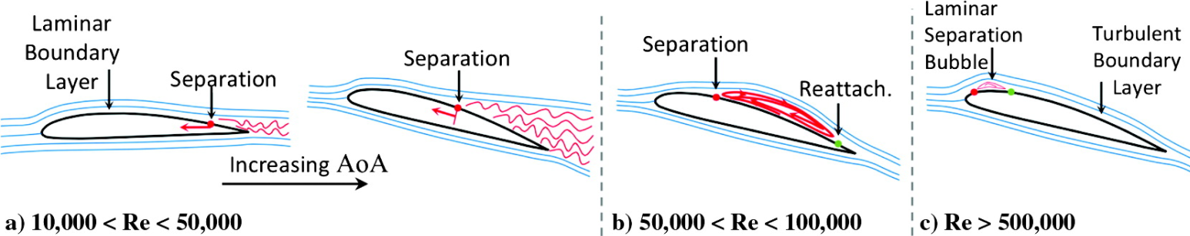
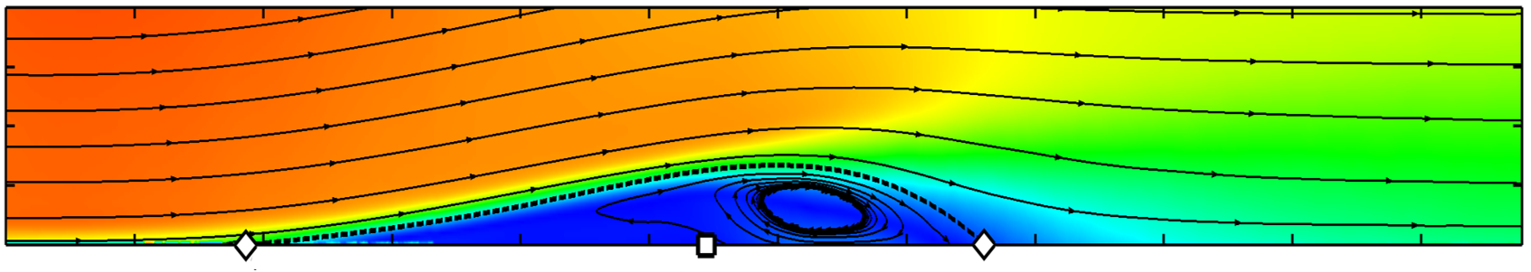
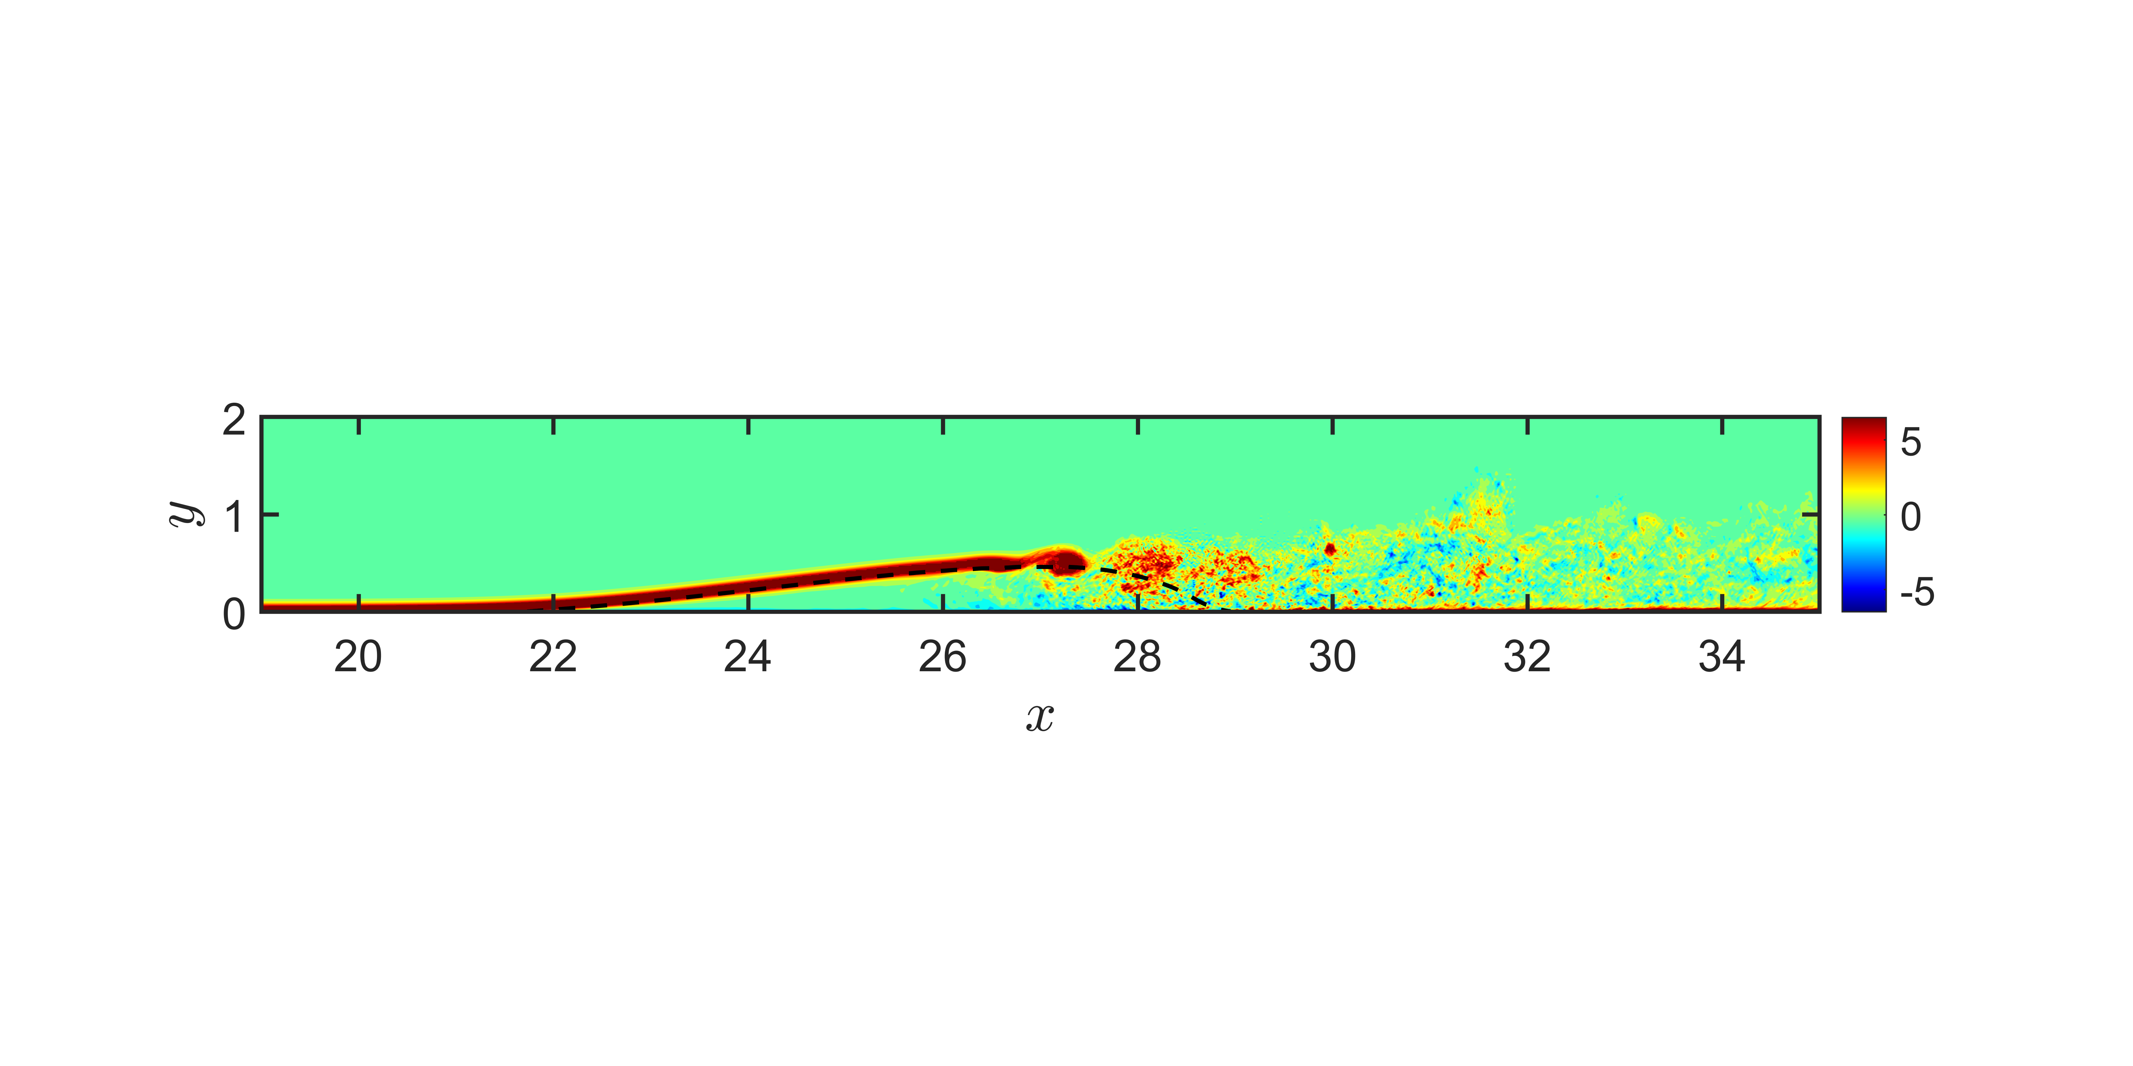
Laminar Separation Bubble (LSB)
Forms on suction side of thin airfoils when laminar boundary layer is subjected to a strong adverse pressure gradient
Slow moving, circulating air
Modifies effective shape of airfoil
Hinders aerodynamic performance
Winslow, J., Otsuka, H., Govindarajan, B., Chopra, I., “Basic Understanding of Airfoil Characteristics at Low Reynolds Numbers,” Journal of Aircraft, Vol. 55, No. 3. May-June 2018
Mean Velocity
Vorticity – instantaneous
Borgmann, D., Hosseinverdi, S., Little, J., Fasel, H., “Investigation of Laminar Separation Bubbles Using Experiments, Theory and DNS,” AIAA, Jul 2021

Slide 3
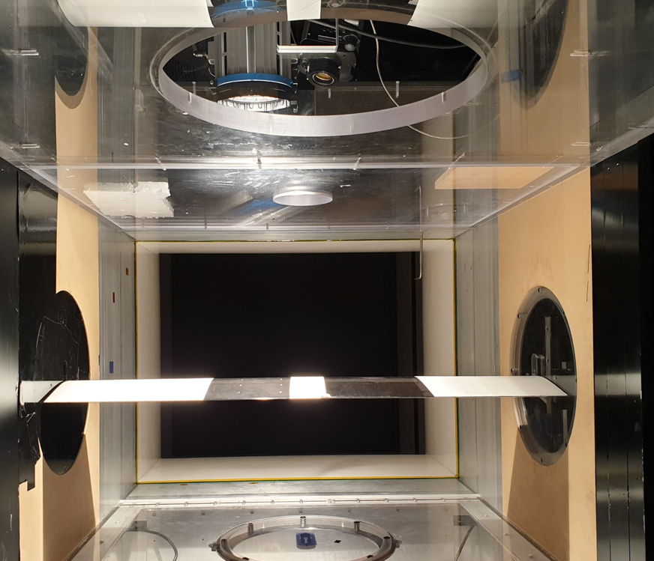
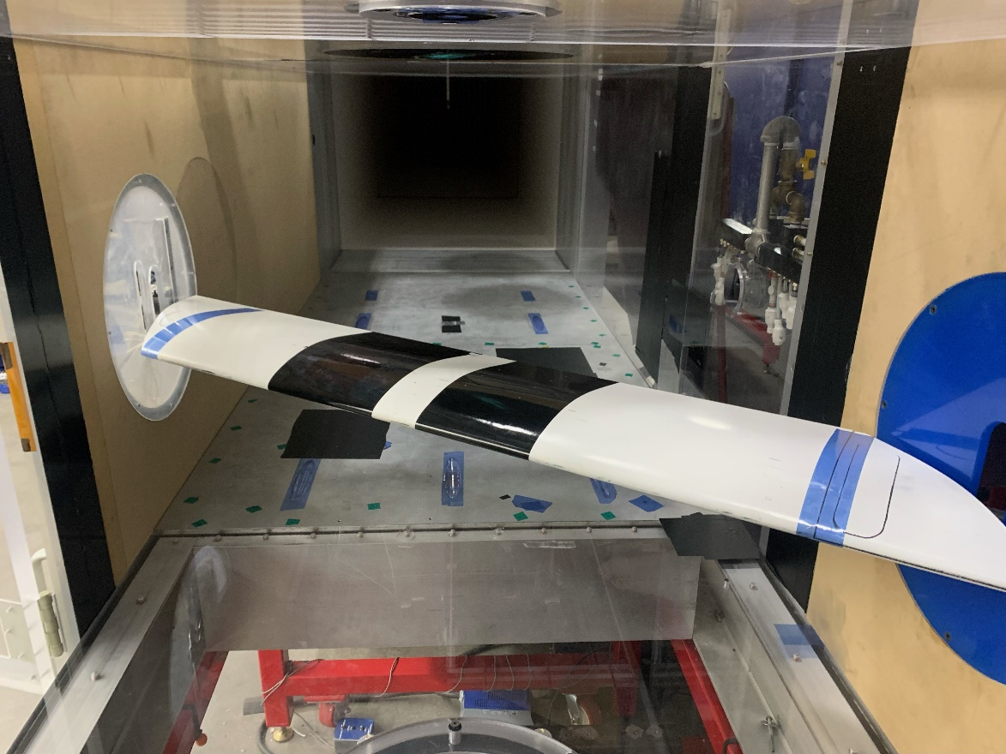
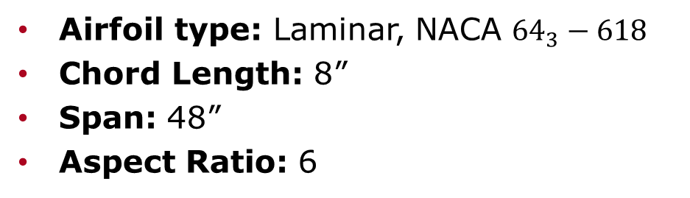
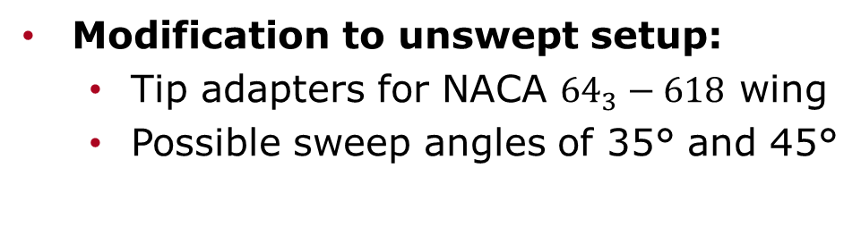
Experimental Setup
Unswept
Swept
35 °
Airfoil type: Laminar, NACA $64_{3}−618$
Chord Length: 8”
Span: 48”
Aspect Ratio: 6
Modification to unswept setup:
  Tip adapters for NACA $64_{3}−618$ wing
  Possible sweep angles of 35° and 45°

Slide 4
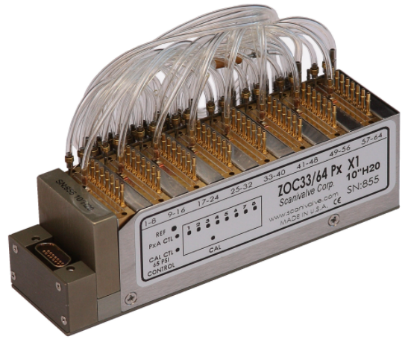
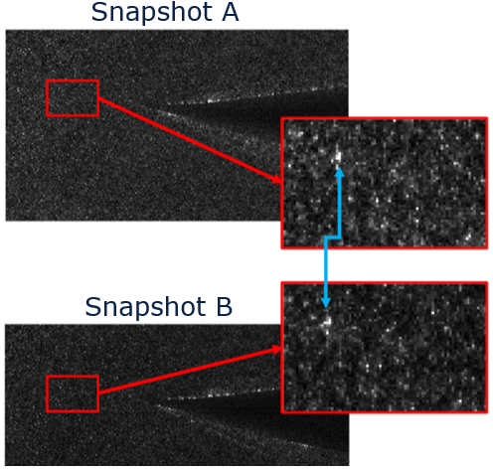
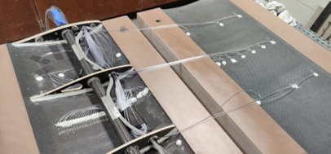
Equipment
Scanivalve Zoc33 pressure scanner
  10 inH₂0 range
  ±0.05 inH₂0 accuracy
Particle Image Velocimetry (PIV)
  High powered laser illuminates seeded flow
Source: Scanivalve, Zoc33

Slide 5
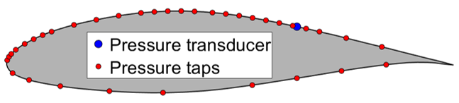
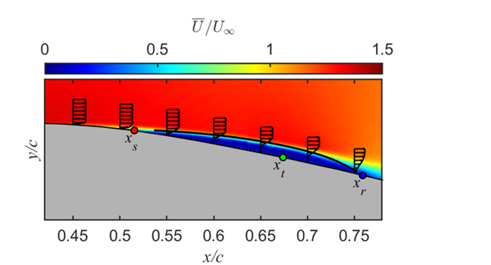
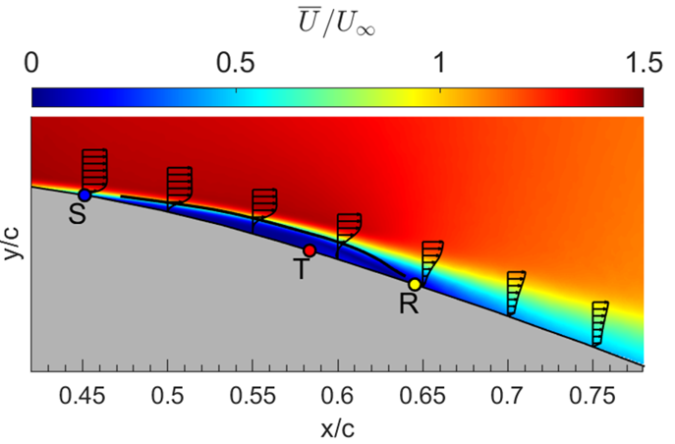





LSB Results (Unswept Wing)
NACA $64_{3}−618$
LSB moves upstream as Angle of Attack (AOA) increases
$$α=0°$$
$$α=6°$$
Guerra, A., Hosseinverdi, S., Little, J., Fasel, H., “Unsteady Behavior of a Laminar Separation Bubble Subjected to Wing Structural Motion,” SciTech, Dec 2021
Notes:
Max shape factor at transition
Shape factor: displacement/momentum thickness
Shape factor lower in turbulent
Shape factor indicator where transition likely happens

Slide 6
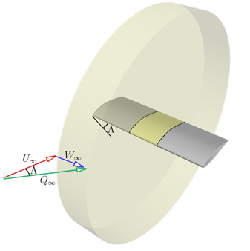
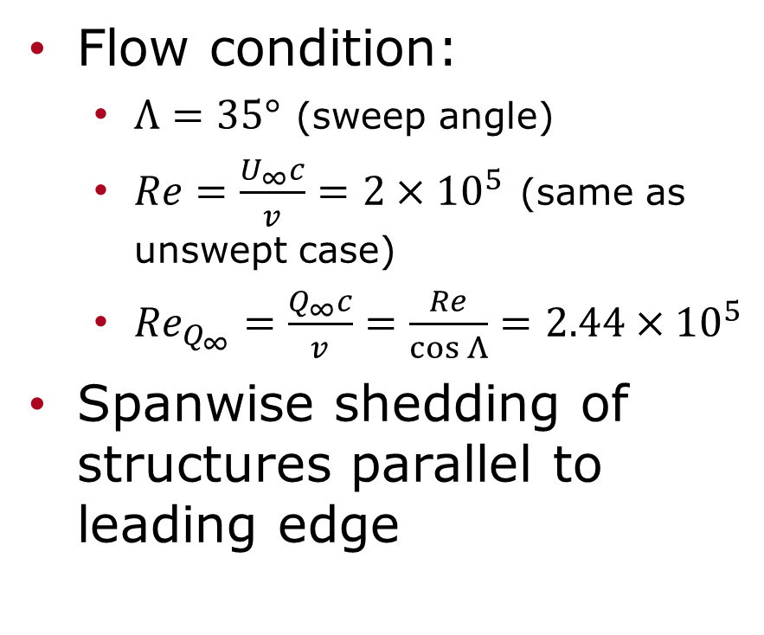
Swept Wing Flow Condition
Flow condition:
  $Λ=35°$ (sweep angle)
  $Re=\frac{U_{∞}c}{v}=2×{10}^{5}$ (same as unswept case)
  ${Re}_{Q_{∞}}=\frac{Q_{∞}c}{v}=\frac{Re}{\cos{Λ}}=2.44×{10}^{5}$
Spanwise shedding of structures parallel to leading edge

Slide 7
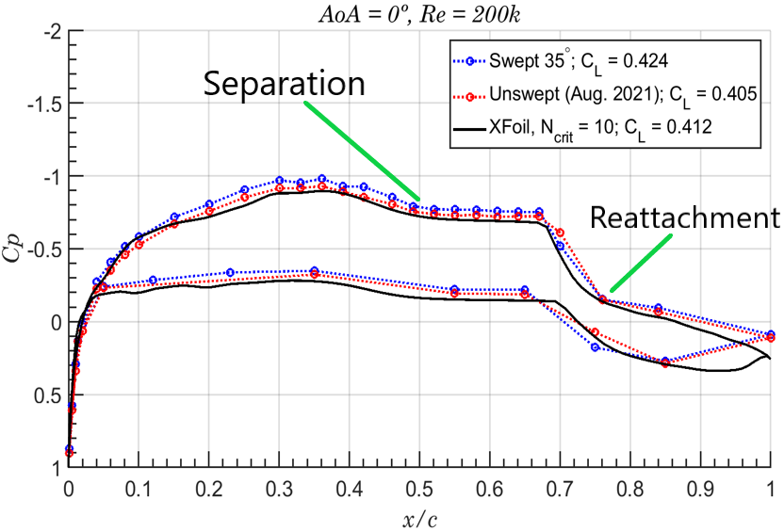
Baseline Characterization
Strong correlation and similar overall behavior
Similar LSB structure
  Same separation and reattachment location
Notes:
This is already a comparison, maybe show another few aoa here. Alek can help with the plots, good pointers towards the locations of sep.
Reattachment is somewhere along the slope between transition and reattachment
Exclude the transition pointer, we don’t know where that happens

Slide 8
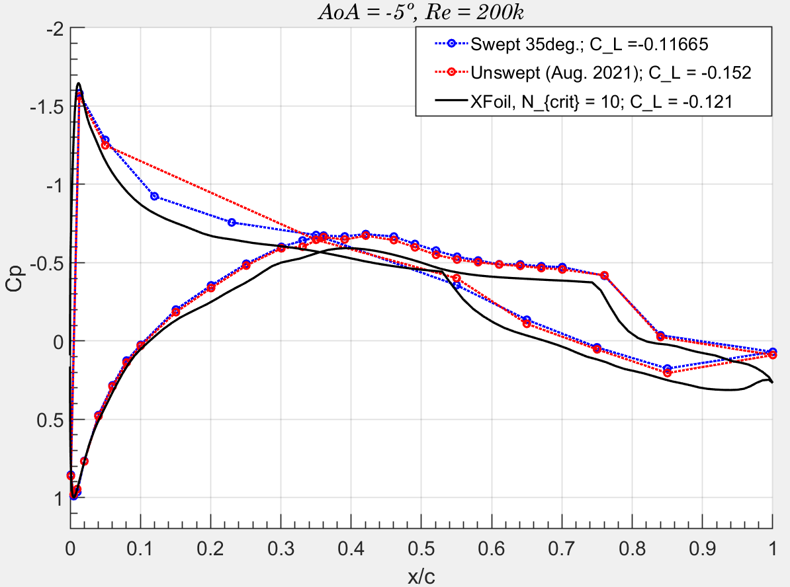
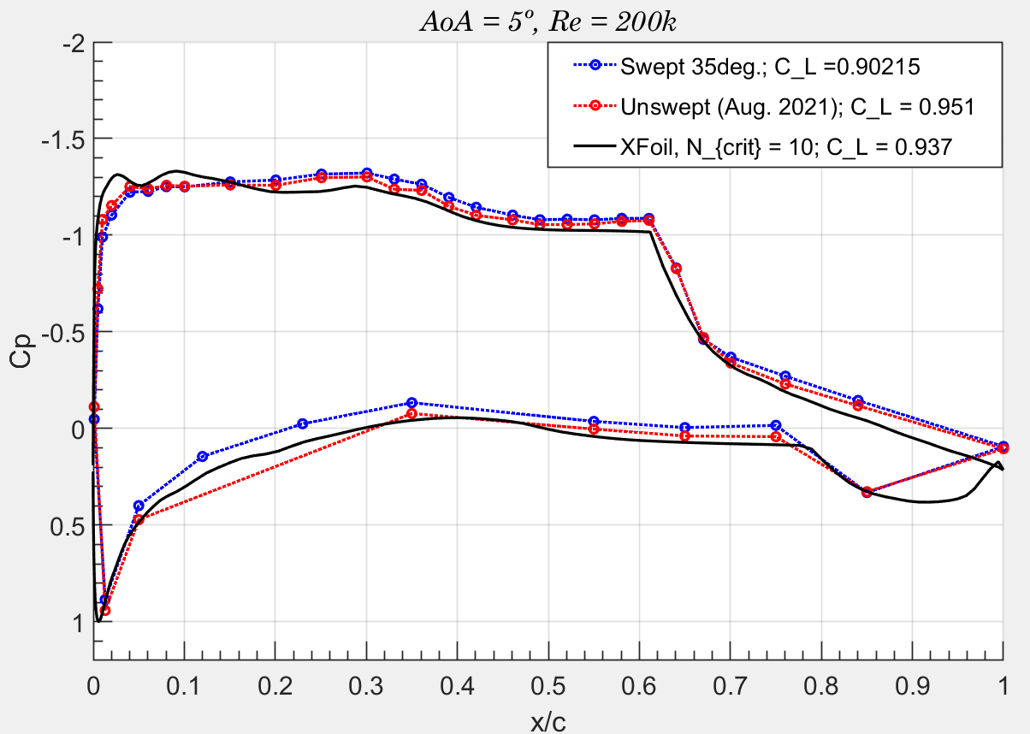
Pressure Distribution Comparison
Static pressure measurements for:
  AOA: -5° to 14° (0.5° increments)
  Re: 100,000 to 300,000 (50,000 increments)

Slide 9
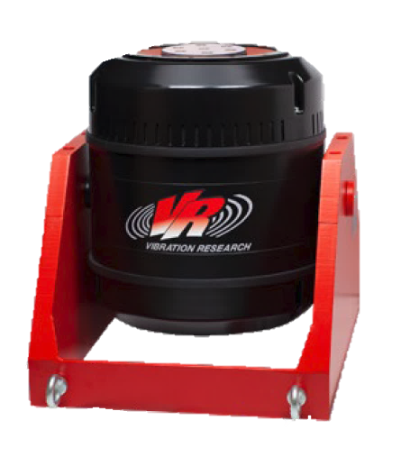
Conclusion Next Steps
Observe similar LSB on both swept and unswept wing
  Same separation and reattachment location
  Coefficient of pressure plots correlate
Conduct different measurement methods (PIV, IR) on fixed, swept wing to expand comparison
Analyze effect of motion and sweep on LSB
  Shaker will plunge wing at selected frequencies
Source: Vibration Research

Slide 10
Thank You

